Slide 1
The joys of javascript
Coding Boot Camp

Slide 2
How are we doing?
Any questions from Saturday?
Anything on your mind about HTML or CSS?
PLEASE: Create a github pages for your first homework assignment (sorry for the confusion, but it will make it much easier to grade and provide feedback on)

Slide 3
Today’s goals
Understand the role javascript plays in web sites.
Write basic javascript code.

Slide 4
What’s missing?
What features of common websites do you still not know how to accomplish?

Slide 5
Representing data
How do you represent information from the world?

Slide 6
Representing data
How do you represent information from the world?
Booleans
Numbers
Strings & Characters
Arrays
Objects

Slide 7
Program flow
Proceed line by line and do what the line says.
Basic logic (if then else)
Doing the same thing repeated (while do)

Slide 8
This is the foundation
Everything builds on these concepts, they are vital to understand.
Re-do the exercises, and try others online.
Ask for help.
Don’t be afraid, it may seem foreign, but you’ll get it eventually.

Slide 9
Variables: storing data
Think of variable as the nouns of programming. They are things.
We store different types of data in variables.
var cost = 1.99;//any digit, optionally follows by a dot, then more digits.
var name = “Jeffrey Jones”;//quotes are required for strings.
var fun = true;//only valid values are true and false.
var variable name = variable value;

Slide 10
Expressions: working with data
Expressions are the verbs of programming. They do stuff.
Expressions can be used with variable, like we use nouns with verbs in a sentence.
1 + 1;
“java” + “script”
true && false
var price = cost * quantity;

Slide 11
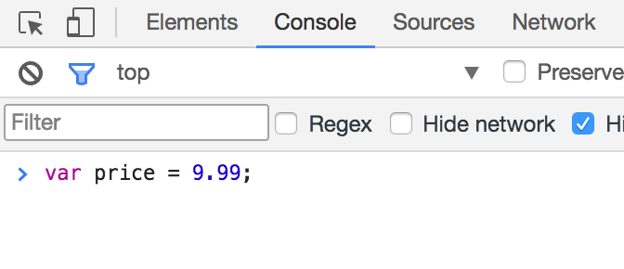
Running code
Use the Chrome console for now.
The console takes a line of javascript, executes it, and gives you the result.
Later we’ll include javascript files in our html.

Slide 12
Assignment: the basics
Use the console to set variables and execute expressions.
Add two Numbers. You can try other math operations as well.
Try using variables as well.
Add two Strings.
Try using variables as well.
And (&&) two Booleans
Try using variables as well.
Explore and try different combinations. Mix and match types. Try other operators.
https://developer.mozilla.org/en-US/docs/Web/JavaScript/Guide/Expressions_and_Operators

Slide 13
Communicating
The browser exposes the console to us in javascript, we can use log to write things to the console.
console.log(“test”);
We can also interact with the user through the browser. The browser can alert, prompt, and confirm.
alert(“test”);//simply show a message
confirm(“test”);//confirm yes or no
prompt(“test”);//ask the user for information

Slide 14
Including scripts
We can include javascript files in our html using the <script> tag.
Save a file with a .js extension.
index.js
<script src=“index.js”></script>
Or just place script in the <script> tag as we can with <style> and CSS

Slide 15
Assignment: include & communicate
Create an HTML Document, and include a <script>.
Use console.log().
Use prompt().
Place the value from prompt in a variable, and console.log it.
Use confirm().
Place the value from prompt in a variable, and console.log it.
Use alert().

Slide 16
Program flow
We can limit when expression are executing using if and else statements.
if(isTaxable) total = price* tax;
else total = price;
if(selected == 1) msg = “One item selected”;
else if(selected > 1 && selected < 5) msg = “A few items select”;
else msg = “Many items selected”

Slide 17
Assignment: if only
Continuing with your HTML Document:
Prompt the user for their name.
Confirm that they’d like to continue to the site.
If they choose to continue, alert a welcome message.
Otherwise, alert a goodbye message.

Slide 18
Repetition
Often we want to do the same thing many times.
We want to look at all items and check if they are in stock.
We call this a loop, there are different ways to loop.
for(var i = 0; i < 5; i = i + 1)
while(true)
do while(true)

Slide 19
Arrays
An array is a list of variables.
It can be pure (only one type) or a mix of types.
var numbers = [1,2,3,4,5]
var mixed = [1,”blue”,3.0,true];
We can see what is at each index with the following:
mixed[0]//arrays start at 0
mixed[1]
Arrays have a length property to help you navigate them.
for(var i = 0; i < mixed.length; i++)

Slide 20
Assignment: arrays and looping
Continuing with your HTML Document:
Prompt the user for 10 values.
Place those 10 values into an array.

Slide 21
Assignment: find it!
Continuing with your HTML Document:
Prompt the user for a value to find in the array.
Loop through all values in the array, when you find theirs, alert the index.

